Slide 1



Unveiling Urban Crime Patterns: A Hybrid Approach Using DBSCAN Clustering and Hierarchical Clustering
Group 24
Under the guidance of: Prof. Sagar Korde
16010421084 – Sharandeep Singh Rajpal
16010421088 – Sahil Samant
16010421089 – Aditya Sanap
16010421098 – Rahil Shaikh

Slide 2

Introduction
Crime mapping crucial for law enforcement and urban planning, aiding in analyzing criminal activity patterns.
Traditional methods sometimes lack accuracy in identifying clusters and understanding root causes.
Hybrid models blend algorithms like DBSCAN for spatial clustering and Hierarchical Clustering.
Integration of multiple algorithms enhances precision and effectiveness.
Presentation explores synergy of techniques to revolutionize crime mapping for safer communities.

Slide 3
Problem Definition
Problem: Identifying and analyzing crime spatial patterns in urban areas.
Limitations: Conventional methods may miss spatial differences.
Solution: Comprehensive approach integrating spatial clustering.
Enhancement: Leveraging graph databases for complex network analysis.

Slide 4
Objectives
To identify spatial clusters of crime incidents using DBSCAN clustering.
Utilize Hierarchical clustering to group similar crimes, offering a hierarchical view of crime distribution.
To integrate crime data and analysis results into a Neo4j graph database for enhanced visualization and network analysis.
To provide actionable insights for urban planners and law enforcement agencies to address crime hotspots effectively.

Slide 5



Tech Stack
Neo4j Python Jupyter Notebook

Slide 6
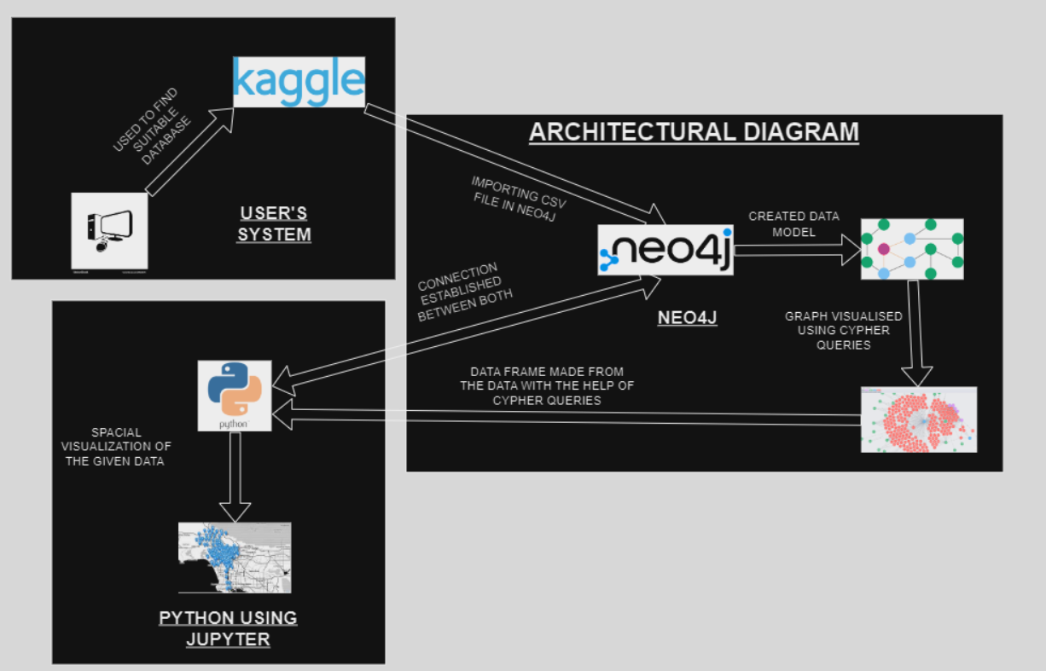
Architectural Diagram

Slide 7
Dataset Description
Source: Obtained from Kaggle, a platform for data science and machine learning projects.
Attributes: Includes crucial information such as location, crime description (robbery, burglary, etc) , longitude, latitude, date occurred, date reported, victim sex, victim age, crime code,
Spatial Scope: The dataset covered specific crime locations within Los Angeles using Longitude and Latitude.
Volume: The dataset comprises approximately 2000 crime incident records, with a file size of 500 kilobytes.
Temporal Scope : Duration covered by the dataset is December 2023.

Slide 8
Literature Survey
Sr .No | Title | Publication year | Goal | Result | Limitations
1. | Self-Organizing Map (SOM) For Diagnosis Coronary Heart Disease | IEEE 2023 | Utilize SOM for CHD classification to enhance early diagnosis accuracy. | SOM achieves 62.5% accuracy in CHD diagnosis, demonstrating effectiveness. | Data size and parameter sensitivity necessitate further validation and optimization for improved performance.
2. | Analysis of Disease Data Based on Neo4j Graph Database | IEEE 2022 | Explore disease data analysis using Neo4j graph database, emphasizing its efficiency in representing complex relationships. | The paper introduces Neo4j's Cypher query language for intuitive data analysis and demonstrates creating a disease database. | It highlights Neo4j's suitability for handling large, low-structured data, particularly in retrieving related diseases based on symptoms

Slide 9
Literature Survey
Sr .No | Title | Publication Year | Goal | Result | Limitations
3. | Implementation of Graph Database for OpenCog Artificial General Intelligence Framework using Neo4j | IEEE 2022 | Paper improves OpenCog with Neo4j integration for better knowledge management, using ZeroMQ for data access and interoperability. | OpenCog integrates Neo4j via ZeroMQ for knowledge management, aligning with Linked Data tech for collaboration with AI researchers. | Paper's limitations: scaling for larger datasets, maintaining compatibility with evolving Neo4j and OpenCog versions.
4. | Downscaling of Urban Land Surface Temperature Based on Multi-Factor Geographically Weighted Regression | IEEE 2020 | Study aimed to estimate urban tree AGB, overcoming challenges of land use heterogeneity, demonstrating remote sensing and GWR potential for biomass estimation. | GWR model, Worldview-3 satellite, and LiDAR data estimated urban tree biomass in Hengqin, Guangdong, with superior performance over SVR model. | Study noted uncertainties in urban tree AGB estimation due to complex environments, with limitations in accurately estimating AGB beyond certain biomass thresholds.

Slide 10
Literature Survey
Sr .No | Title | Publication Year | Goal | Result | Limitations
5. | An Improvement of DBSCAN Algorithm to Analyze Cluster for Large Datasets | IEEE 2019 | Enhancing DBSCAN algorithm for analyzing clusters in large datasets by automating parameter selection and evaluating its performance across different datasets. | Enhanced DBSCAN efficiently handles large datasets, forming clusters with increased dataset size and computational time. | Paper's main drawback: manual parameter setup for Epsilon and Minimum Points is difficult; algorithm lacks full scalability solutions.

Slide 11
Methodologies
Data Retrieval and Preparation: Utilize Py2neo library to connect to Neo4j Aura database, retrieve crime data via Cypher query, and extract relevant attributes, storing them in a pandas DataFrame.
DBSCAN Clustering: Instantiate a DBSCAN clustering object with specified parameters (e.g., epsilon=0.2, min_samples=5) to identify spatial clusters of crime incidents, fitting the model to latitude and longitude coordinates and assigning cluster labels.
Hierarchical Clustering: Initialize an AgglomerativeClustering object with a predefined number of clusters (e.g., n_clusters=5) and linkage method ('ward'), training the model on latitude and longitude coordinates and assigning cluster labels.
Hybrid Clustering: Merge DBSCAN and Hierarchical Clustering results, defining hybrid cluster labels based on predetermined criteria and updating the DataFrame accordingly.
Update Neo4j Aura DB: Iterate through the DataFrame, updating the Neo4j Aura database with hybrid cluster information for each crime incident via Cypher queries, matching crime nodes based on case number and setting cluster properties.
Visualization: Plot crime clusters on a scatter plot using Matplotlib and Seaborn, color-coding clusters for easy interpretation.Create an interactive map using Folium to visualize crime incidents, with markers indicating each incident and color-coded by hybrid cluster label, enhancing visualization.
Export and Sharing: Save the interactive map as an HTML file using Folium's save() method, ensuring compatibility across different web browsers and platforms for easy sharing and distribution.

Slide 12
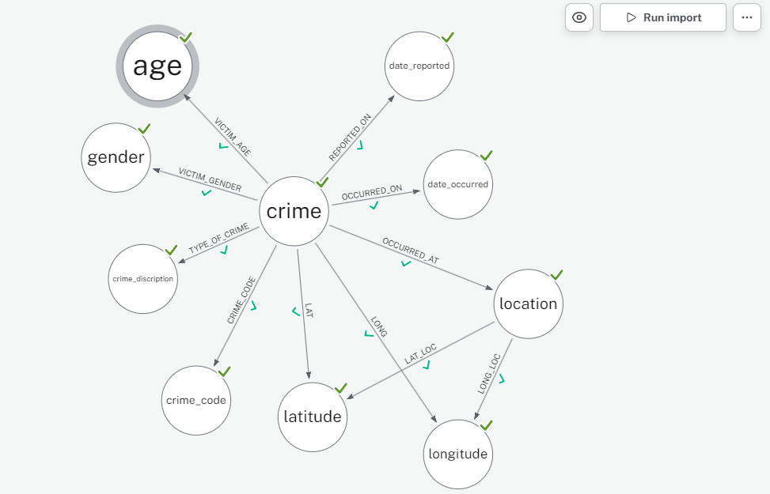
Results
Data Model made in Neo4j

Slide 13
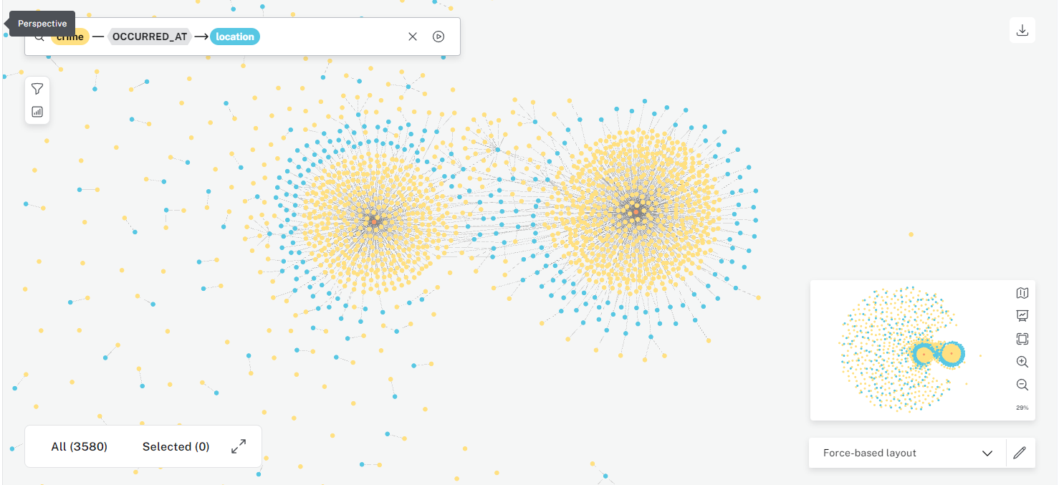
Results
Neo4j Model Visualized

Slide 14
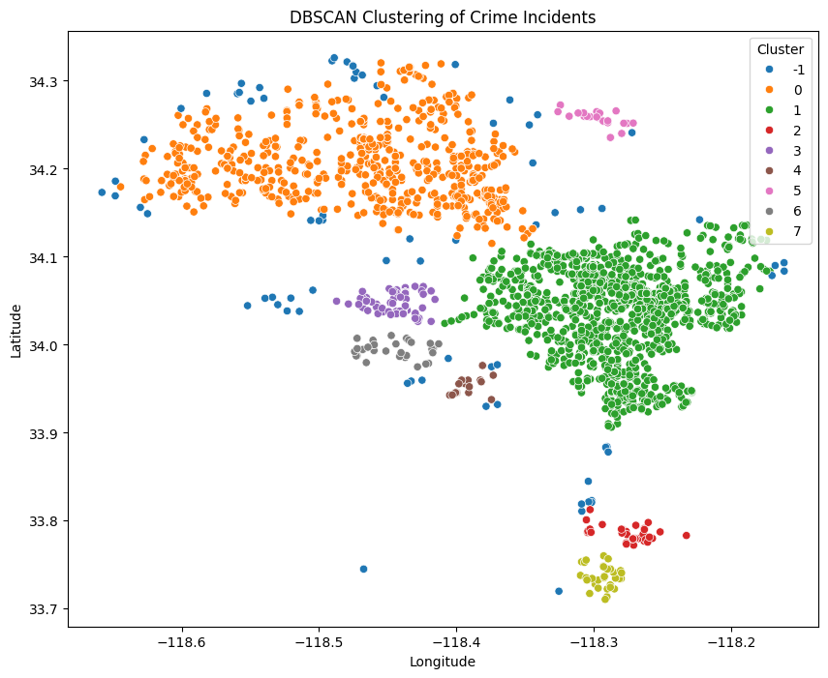
Results
DBSCAN Clustering

Slide 15
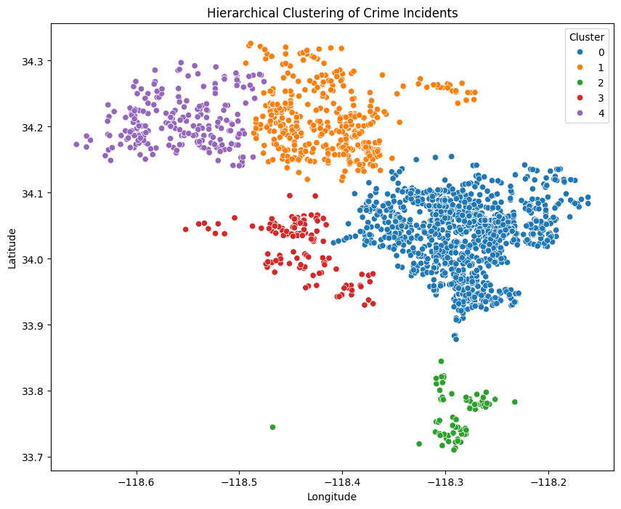
Results
Hierarchical Clustering

Slide 16
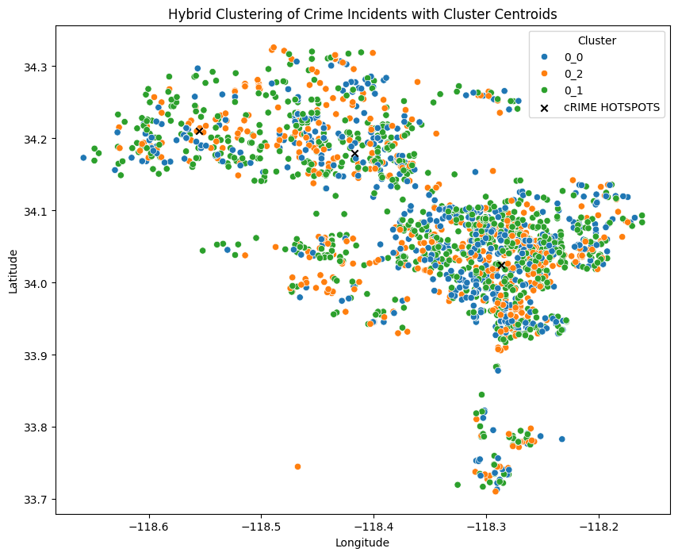
Results
Hybrid Clustering

Slide 17
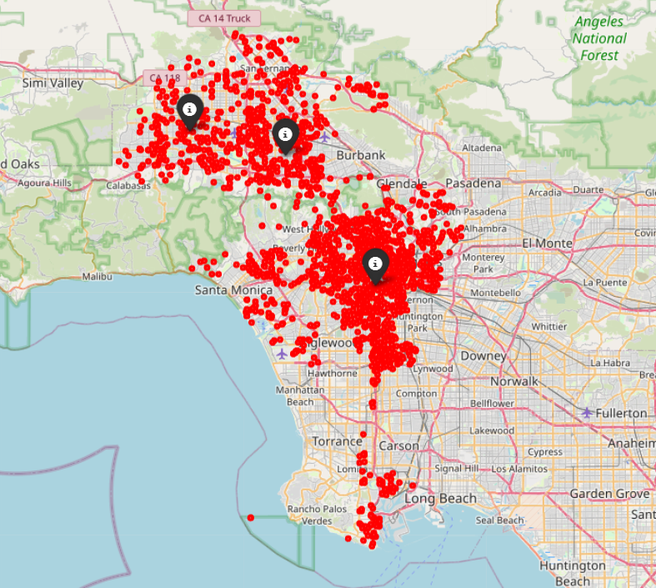
Results
Hybrid Clustering

Slide 18
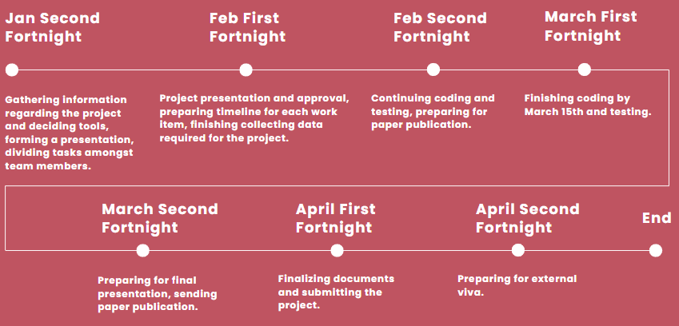
Timeline

Slide 19
Conclusion
DBSCAN clustering identifies crime hotspots, while hierarchical clustering reveals socio-economic patterns. Integrated into Neo4j, these methods inform proactive urban planning and law enforcement. Insights guide targeted interventions, optimizing resource allocation and enhancing community safety.
Advanced analytics empower stakeholders with evidence-based strategies for crime prevention, fostering resilient urban environments.

Slide 20
References
Self-Organizing Map (SOM) For Diagnosis Coronary Heart Disease
T. Widiyaningtyas, I. A. E. Zaeni and P. Y. Wahyuningrum, "Self-Organizing Map (SOM) For Diagnosis Coronary Heart Disease," 2019 4th International Conference on Information Technology, Information Systems and Electrical Engineering (ICITISEE), Yogyakarta, Indonesia, 2019, pp. 286-289, doi: 10.1109/ICITISEE48480.2019.9003746.
Analysis of Disease Data Based on Neo4j Graph Database
J. Zhao, Z. Hong and M. Shi, "Analysis of Disease Data Based on Neo4j Graph Database," 2019 IEEE/ACIS 18th International Conference on Computer and Information Science (ICIS), Beijing, China, 2019, pp. 381-384, doi: 10.1109/ICIS46139.2019.8940247.
Implementation of graph database for OpenCog artificial general intelligence framework using Neo4j
H. Irawan and A. S. Prihatmanto, "Implementation of graph database for OpenCog artificial general intelligence framework using Neo4j," 2015 4th International Conference on Interactive Digital Media (ICIDM), Bandung, Indonesia, 2015, pp. 1-6, doi: 10.1109/IDM.2015.7516355.
Downscaling of Urban Land Surface Temperature Based on Multi-Factor Geographically Weighted Regression
Widiyaningtyas, T., Zaeni, I. A. E., & Wahyuningrum, P. Y. (2019, November). Self-organizing map (SOM) for diagnosis coronary heart disease. In 2019 4th International Conference on Information Technology, Information Systems and Electrical Engineering (ICITISEE) (pp. 286-289). IEEE.
An improvement of DBSCAN Algorithm to analyze cluster for large datasets
C. Dharni and M. Bnasal, "An improvement of DBSCAN Algorithm to analyze cluster for large datasets," 2013 IEEE International Conference in MOOC, Innovation and Technology in Education (MITE), Jaipur, India, 2013, pp. 42-46, doi: 10.1109/MITE.2013.6756302.

Slide 21
Thank You

